Slide 1
Supercomputing 2016 Network Architecture and Demonstrations
Version: 11/3/16

Slide 2
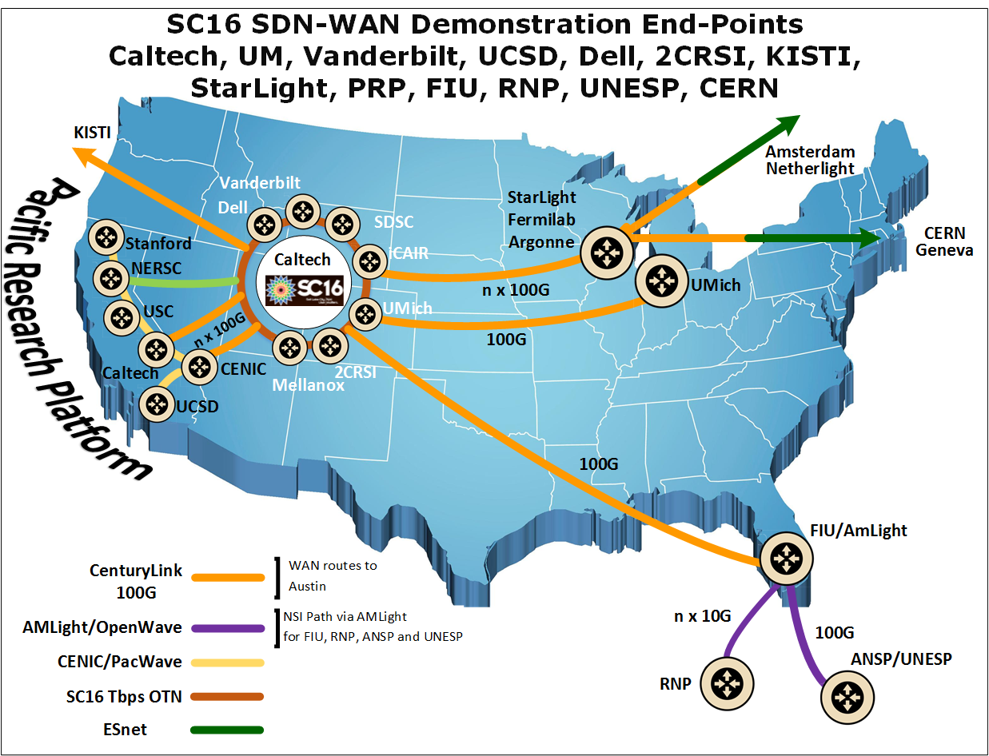

Slide 3
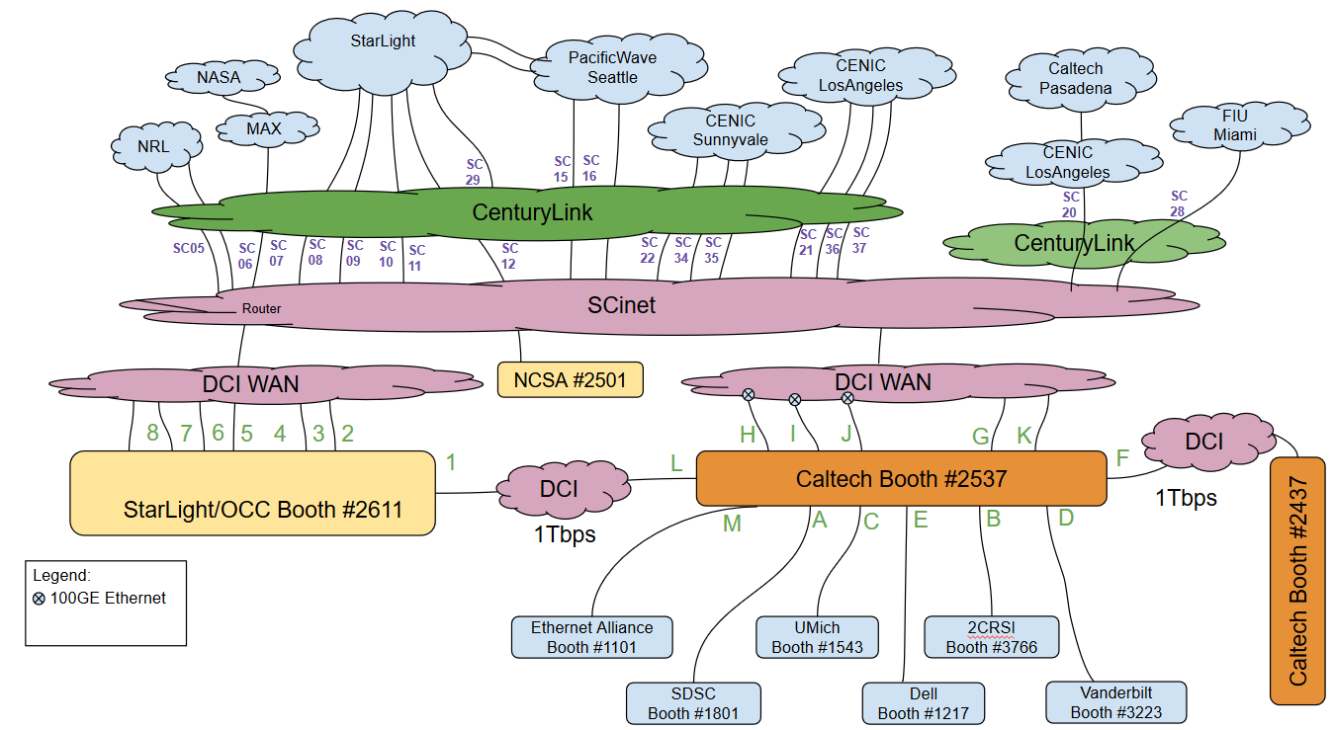
WAN and Inter-booth Connections

Slide 4
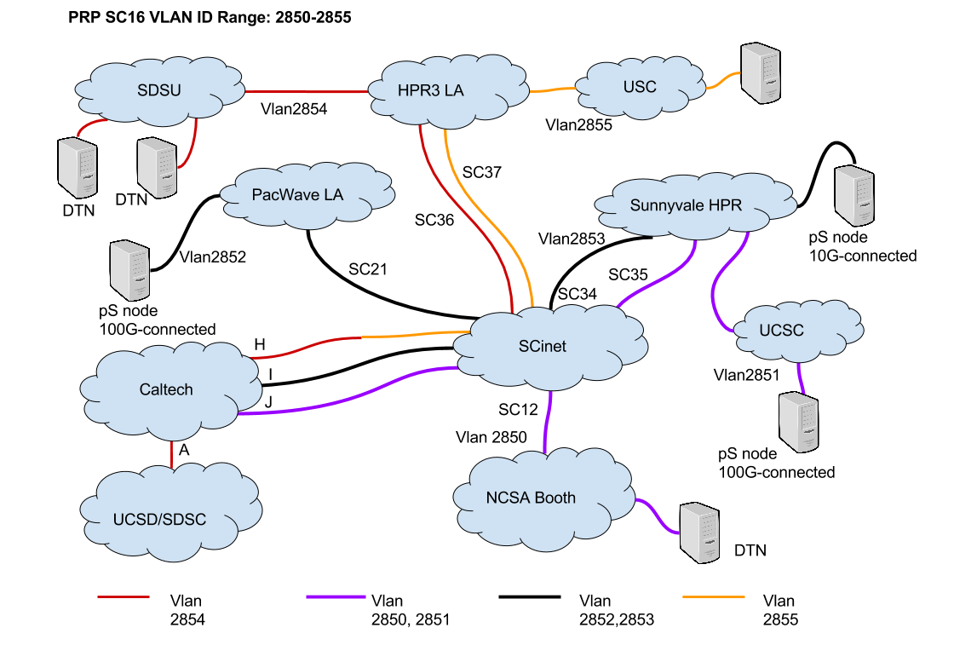
PRP WAN Connections
Los Angeles
3 x 100GE links at 818 Los Angeles
Shared among CENIC connected sites
1 x 100GE (600->818) Los Angeles
Dedicated for Caltech
Sunnyvale
3 x 100GE links
Shared among (UCSC, CENIC perfSONAR)
Other campuses …
Layer2 Infrastructure
6 Vlans

Slide 5
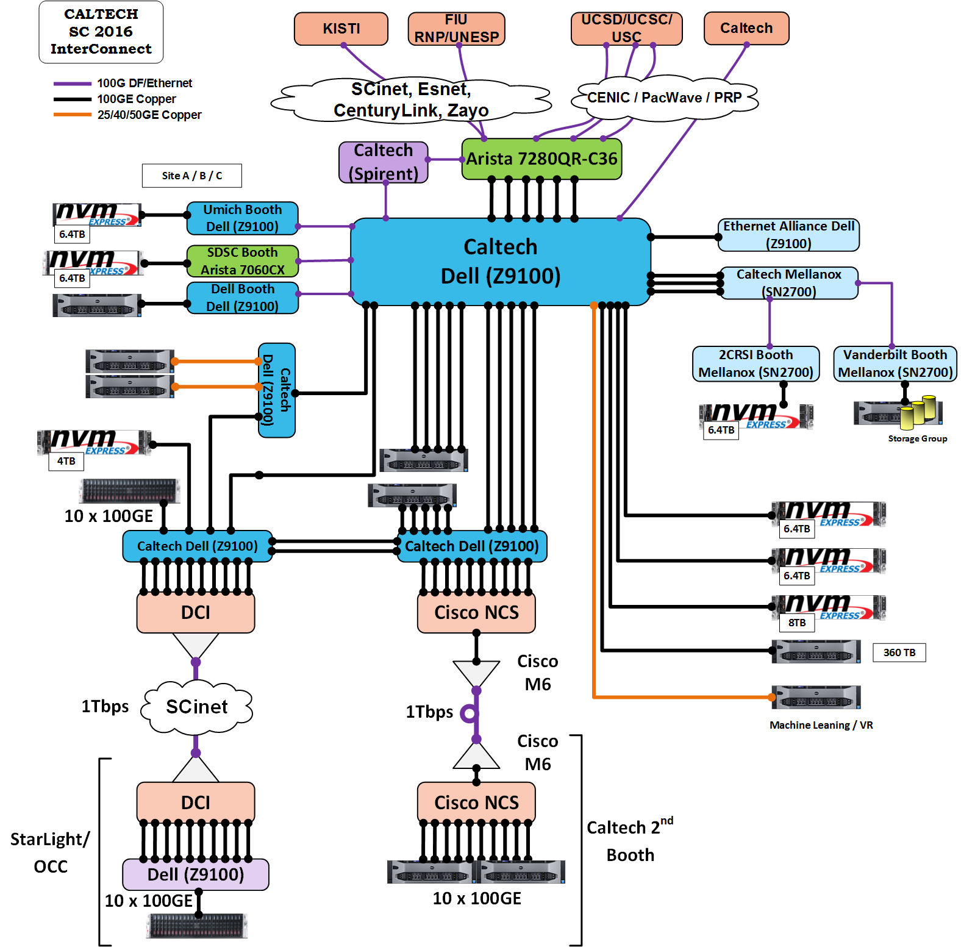
Booth Connections
All the connections to booths are through the OTN Metro DCI Connections
1Tbps Booths
Caltech Caltech
Caltech StarLight
SCinet
100GE Booths
UMich
Vanderbilt
SDSC
Dell
2CRSi
Ethernet Alliance
Connections
5 x WAN
7 x Dark Fiber
2 x 1Tbps

Slide 6
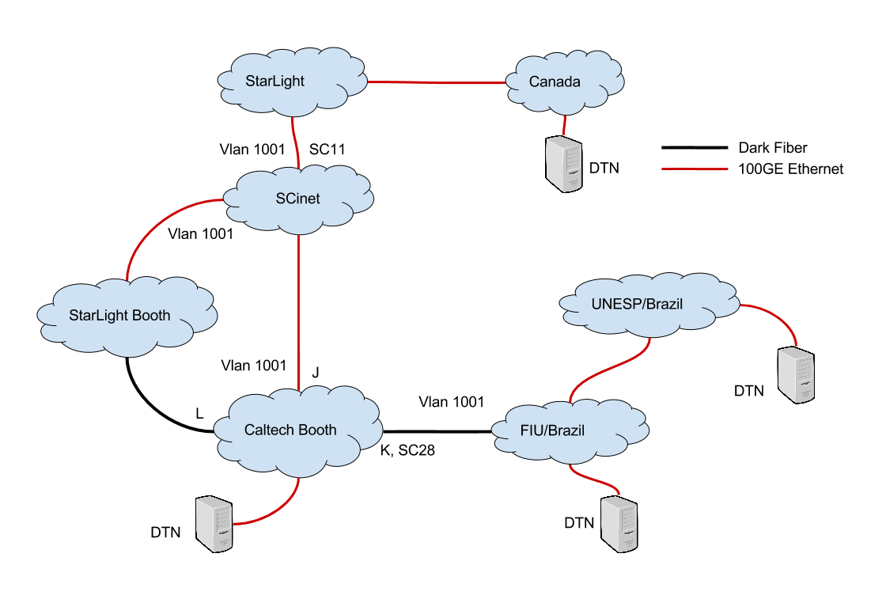
Connection to Brazil
100G dedicated connection to FIU
FIU connects to ANSP and UNESP at 100G from Miami
100G Demonstration Plans
Caltech-FIU Network to Network
Caltech-UNESP
Network – Network
FIU to Compute Canada
via StarLight

Slide 7
List of Demonstrations

Slide 8
SDN
Infrastructure at SC fully programmable using the SDN controller
Flow installation using:
Operator view (full control on infrastructure)
Science applications (done by the ALTO engine)
Science DMZ Flow programming using BRO
Rapid application development for Networkers / Scientist
Physics Applications
Virtual Reality for CMS detector/beams View
Machine Learning for CMS data
DTN Throughput
PRP 100GE Disk to Disk (DTN to DTN)
PRP 100GE Network to Network
NVME over Fabric among DTNs
Single Server 200Gbps file transfers
1 Tera bps demos
RDMA (RoCE) among a pair of server
TCP/IP based among 4 systems

Slide 9

ExaO: EXAscale Data Transfer Orchestrator
ExaO
Rest Interface
ExaO
Rest Interface
ExaO
Rest Interface
ExaO
Rest Interface
ExaO
Rest Interface
Scheduler
Phedex
ExaO
Rest Interface
DB
ExaO
Rest Interface
FDTDaemon
ASO
Transfer Execution Nodes
ALTO
MLSensor
Kibana Monitoring
Kibana Monitoring
Kibana Monitoring
Batch
Monalisa
FDTDaemon
FDTDaemon
MLSensor
MLSensor

Slide 10
ExaO: EXAscale Data Transfer Orchestrator
End-to-end orchestration of data flows involving multiple host groups at different domains,
RESTFul-API: allow users submit and manage transfer request through different interface
ALTO: collect minimal, real-time network information from different domains
ExaO Scheduler: centralized, efficient file-level source and rate co-scheduling
FDT: efficient data transfer tools on end hosts
Monalisa: Distributed monitoring infrastructure for real time monitoring each flow, transfer
Minimally invasive change on end host groups
Real-time, dynamic resource allocation under the existence of other network traffic
Not CMS or HEP specific, hence support any data intensive sciences.
Dataset distribution from one site to N sites:
~100% link utilization in the testbed
N times faster than dataset-level transfer scheduling

Slide 11
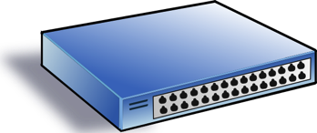
New Tools
Powerful state of the art, generic tools to substantially simplify SDN programming
Before (manual programming)
Complex, manual maven programming
Web IDE
Web-based automatic generation of projects
Programmer focuses only on key aspect
Before (low level programming)
Low-level, complex OpenFlow rule programming
Programmer can define only at flow level
Specific access control allowing only hosts partition
Maple programming (high-level programming)
High-level, completely south-bound agnostic, cross-layer programming
Programmer sees (logically) each and every packet
Integrated access control supporting per-user or role based programming
Before (raw data store)
Complex, manual tracking of execution dependency
Manual cleanup, re-execute
Designed directly on raw data store
FAST (automation function store)
Automatic execution dependency tracking
Automatic cleanup, re-execution (intent ++)
Host generic network functions
Data Store
Before
Ad hoc flow rule installation
FAST Schedule
Consistent, optimized flow-mod scheduling

Slide 12
High-level SDN Programming Abstraction: Function Store (Details; skip)
public void QoSRouting(Ipv4Address src, Ipv4Address dst, int requiredBw) {
srcNode, dstNode = mapToNode(src, dst);
topology = readTopology();
pq.add(srcNode);
while (!pq.isEmpty()) {
n = pq.pop();
if (bw_src(n) < requiredBw)
return failure
if (n == dstNode)
return writeRoute(src, dst, path);
for (e(n->m): n.neighbors) {
if (min(e.bw, bw_src(n)) > bw_src(m)) {
updateBw(m, min(e.bw, bw_src(n)));
...
}
}
}
return failure }
function instance
function instance
function instance
Allow generic functions
Automatically track data dependency
Automatic clean up, reschedule, and re-execute after dependent data changes (achieve intent)

Slide 13

High-level SDN Programming Abstraction: Maple Programming (Details; Skip)
Consider each pkt as a request
- Network as a single virtual server
- Network functions expressed in general purpose language
- Network functions (logically) invoked on each new pkt, returning how net handles that request
- Realization of return is opaque, computed by system

Slide 14
Example Maple Program
Per-packet programming model
Standard+Custom protocols
void f(Packet p) {
if ( !permit(p) ) p.route = null;
else {
EndpointProp sedp = hostTable(p.ip.ipSrc());
EndpointProp dedp = hostTable(p.ip.ipDst());
int rate = p.te.vRate(); // custom protocol
QoSRoute qr = routingAlg(sedp, dedp, rate);
p.route = qr.route; p.vrate = qr.rate;
}
}
QoSRoute routingAlg(EndpointProp s, EndpointProp d, int r) {
if ( allowedRate(s, d) < r ) // authorization
r = allowedRate(s, d);
return QoSRouting(s, d, r);
}
Meta header to control cross layers
Unspecified realization: Source-routing, compile, or on-demand at switches
Notes:
relatively low rate, unreliable, nodes are highly mobile

Slide 15
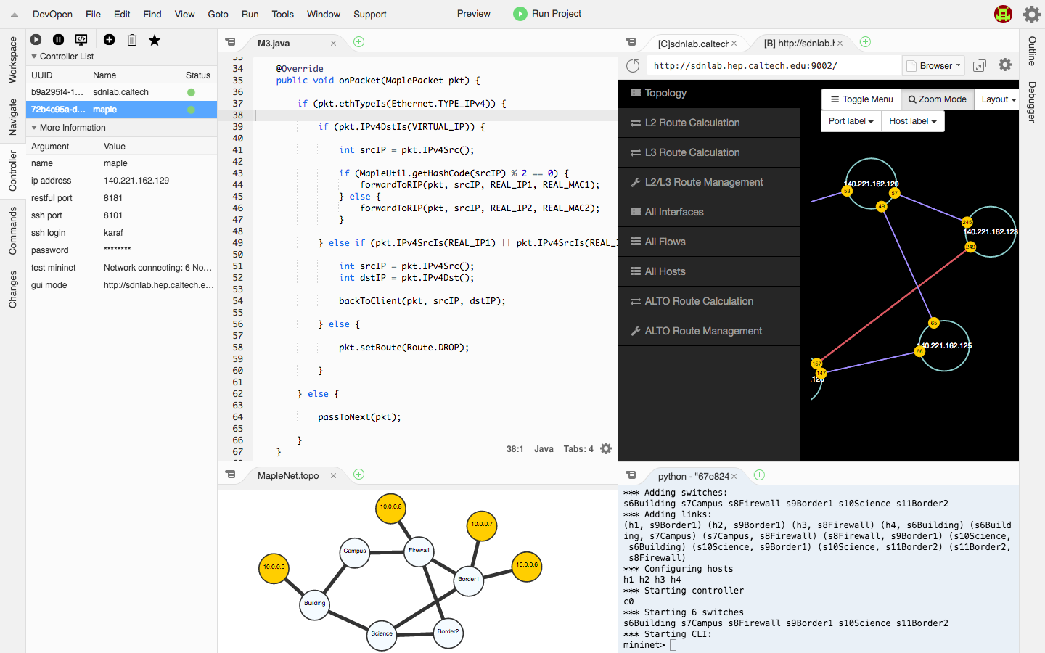
One-click deployment
Web-based UI for real network operation
SDN Controller Information Management
Write Maple program in web-based editor easily
Mininet based tools for network test

Slide 16
New Tools in Action: Programmable Science DMZ
TO FINISH
function cloud
Data-driven function/transport control
Bro
Bro
Bro
RESTCONF /YANG Data Store
transport network

Slide 17
New Tools in Action: Programmable Science DMZ
State updates (RESTCONF/YANG data store as standard interface)
Tapped data controlled using SDN flow programming
Highly selective control to avoid Bro becoming a bottleneck
Bro
SDN Controller
FAST (programming approach) to make controller program state transition oblivious
Incremental vs lambda programming
TAP
Control on data and tapped data
Network
Flexible, generic mechanisms to program the complete system Three control points
What to tap and how to control it ? SDN programming model
How to notify from Middlebox to the SDN controller? (RESTCONF to modify SDN data store)
How to adaptively control the tapping and the original data?
How to program the Middlebox to achieve flexible programing (Bro’s programming model)

Slide 18
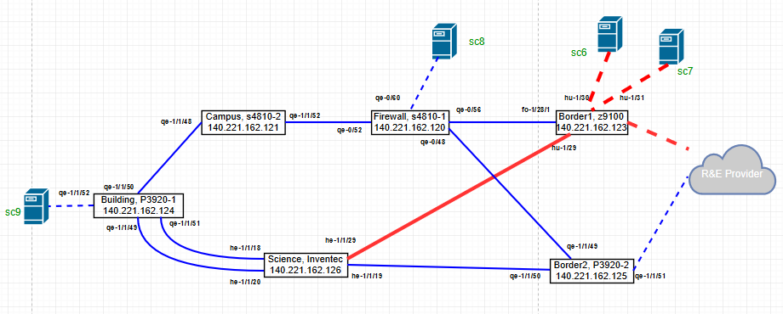
Programmable DMZ using FAST Maple
Flexible, stateful firewall programmed using Bro
Up to Layer 7 detection
Generic FW state update to SDN controller using RESTCONF
SDN control programming using Maple programming, executed in FAST function store
Achievements: only 10s of lines code, for a fully adaptive, highly extensive ScienceDMZ

Slide 19
1Tbps Caltech-StarLight (among two booths)
SCinet has provided DCI inter-booth connection with a total of 8 x 100G links
RoCE based data transfers
A proof of concept to demonstrate the current system capability and

Slide 20
1Tbps Caltech - Caltech
Cisco has provided DCI inter-booth connection with a total of 10 x 100G links
Transfer Application:
FDT: TCP/IP based application for data transfers

Slide 21
Traffic monitoring
OpenFlow STATS
sFLOW (inmon)
Maddash

Slide 23
FASTMapleNet: Easy-to-Program SDN Network for Scientists and Beyond
Powerful state of the art, generic tools to substantially simplify SDN programming
FAST function store
Automatic track execution dependency.
Automatic cleanup, re-execute, schedule network services (intent ++)
Host generic network functions
Maple programming as "omnipresence" programming
Programmer sees (logically) each and every packet
High-level, completely south-bound agnostic
Integrated access control supporting per-user or role based programming
Web based IDE
Simplest approach to achieve a science problem

Slide 24
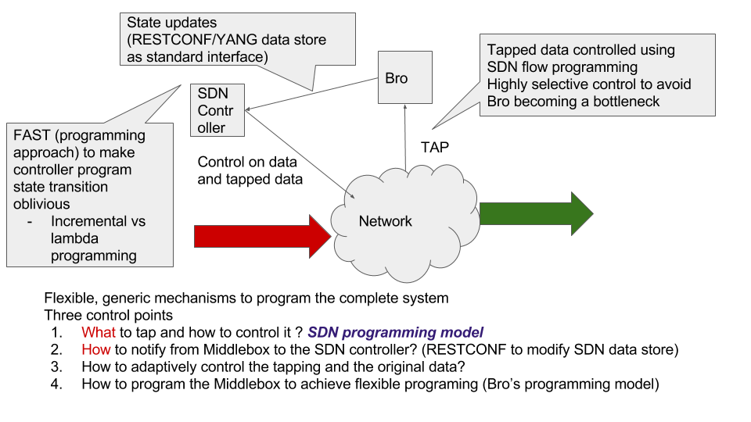
Programmable DMZ using FAST Maple

